Slide 1
Flavors of cacao
CEBD1261- PROJECT
APRIL 28, 2018

Slide 2
TEAM INTRODUCTION
MEMBER 1: TANIA OLIVEIRA GAMEIRO
MEMBER 2: NORA AROUCHIAN

Slide 3
INTRO DATASET
“Flavors of Cacao” dataset comes from Kaggle.
It has thousands of ratings documented from 2006 to 2017.
It highlights customer ratings of chocolate bars, based on the region the cocoa bean is grown, produced, and the percent of cocoa the chocolate bar has in it's ingredients.
The program Python (Anaconda, Jupyter Notebook) was used to conduct the analysis

Slide 4
INTRO USE CASES
Big Data is used when:
Need exact count or exact distribution
Sessionlization sampling isn’t possible
In “Flavors of Cacao” dataset, in order to achieve proper results:
Although we don’t face any time constraint, we need to analyze the full dataset (all records simultaneously)
Data needs to be clean and precise (to avoid wrongful conclusions based on typos, errors, etc.)
Sessionlization shouldn’t come into play as it would infringe on the accuracy of the results. (see next slide)

Slide 5
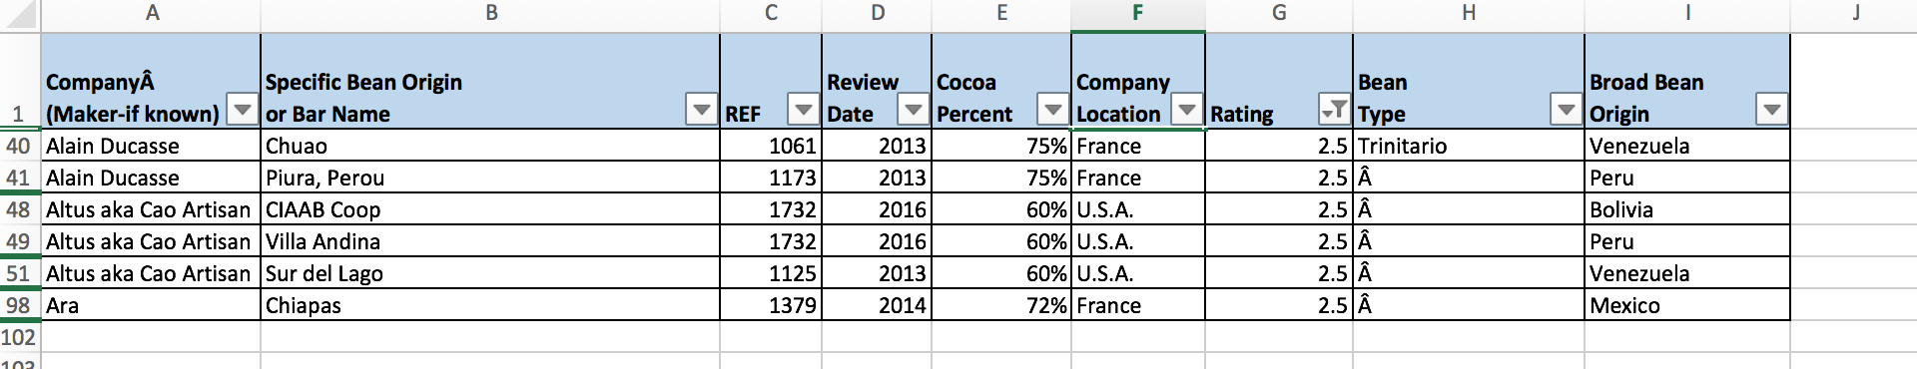
Wrong Big Data Use Case
It does not constitute a Big Data Use Case when any of the previous three conditions are not met.
We could try and use sampling in order to achieve results wanted.
But…
When we limit the interpretation to a subset of 100 lines in excel, the outcome of the questions we were asking based on the dataset was erroneous.
Ex: country with lowest rating is showing France and U.S.A. with a rating of 2.5.
Big Data Analysis will show us this is wrong in later slides.

Slide 6
Flavors of Cacao Results
In this analysis, there are thousands of chocolate bars rated from 63 countries. The most number of ratings that were given was between 3.0 to 3.5, with the highest being 3.5 with a number of around 380 ratings. This shows us that most individuals are giving chocolate bars a rating of a little bit more than satisfactory. (positively skewed)
We chose to use the dataset and answer the following questions:
1) Which country has the highest chocolate consumption?
2) When were the reviews captured?
3) Is there a link between the cocoa percentage and the ratings?
4) Which countries have the highest ratings?
5) Which countries have the lowest ratings?

Slide 7
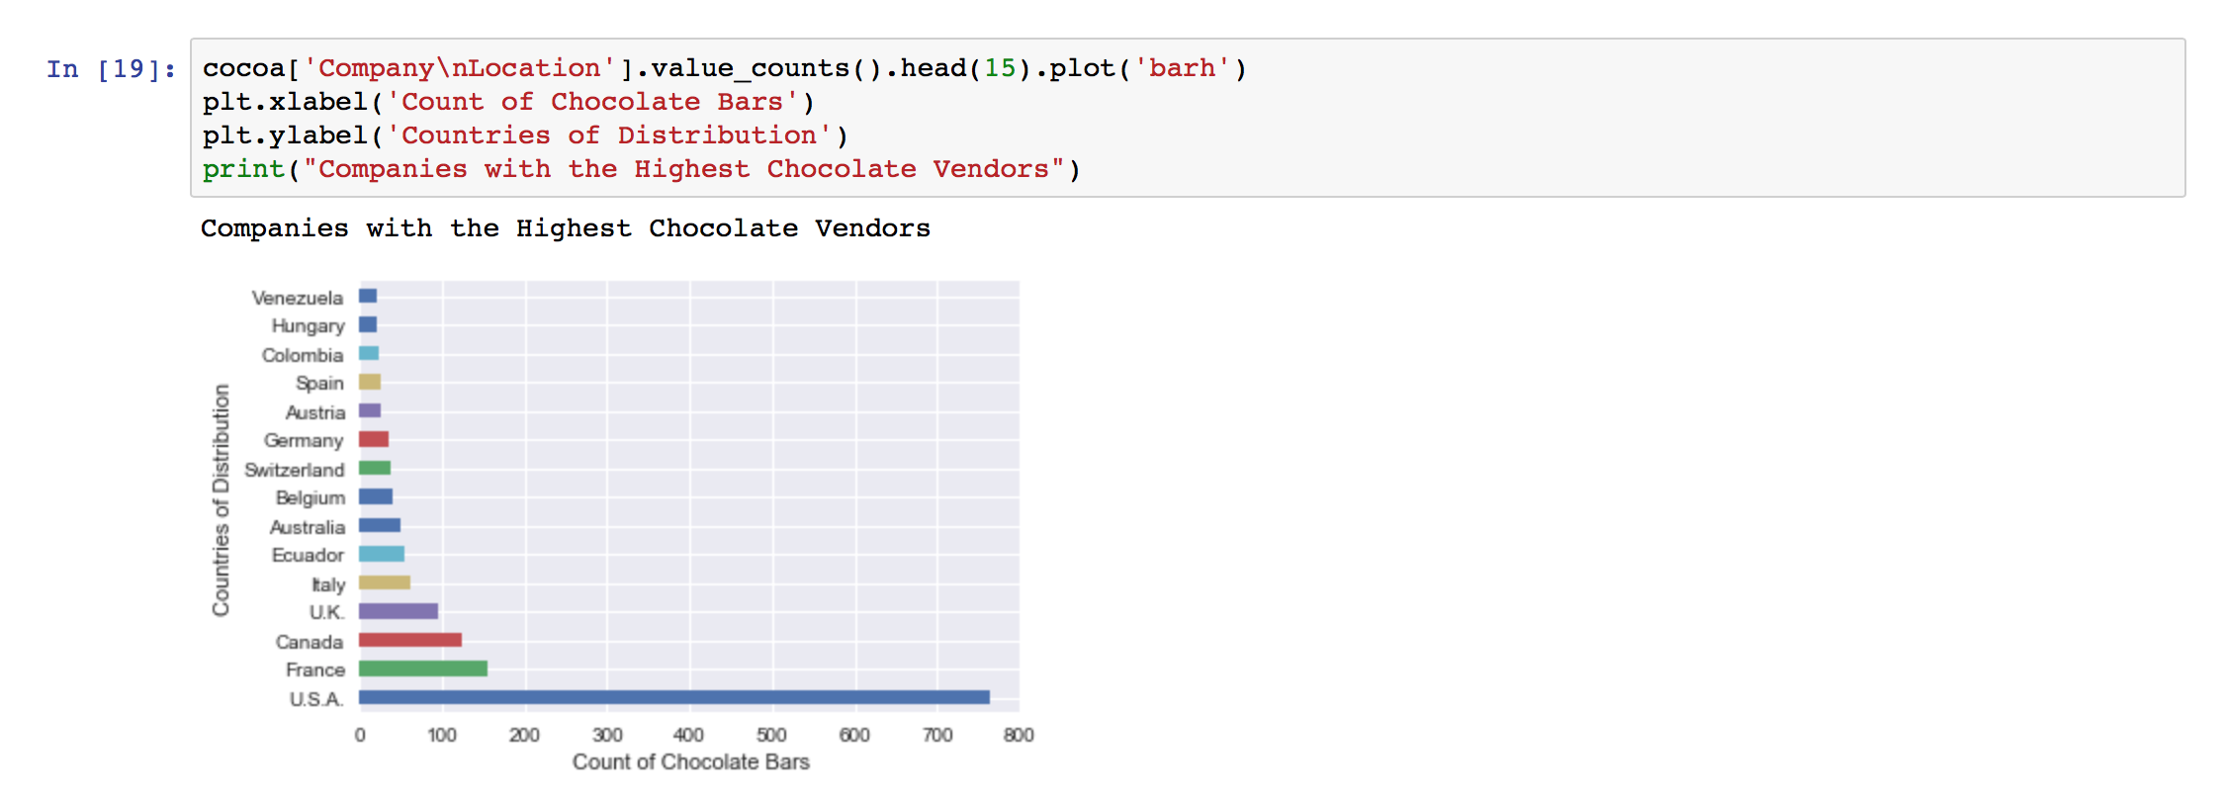
Which country has the highest chocolate consumption?
The data clearly shows that the US consumes chocolate far more than any other country of the world.

Slide 8
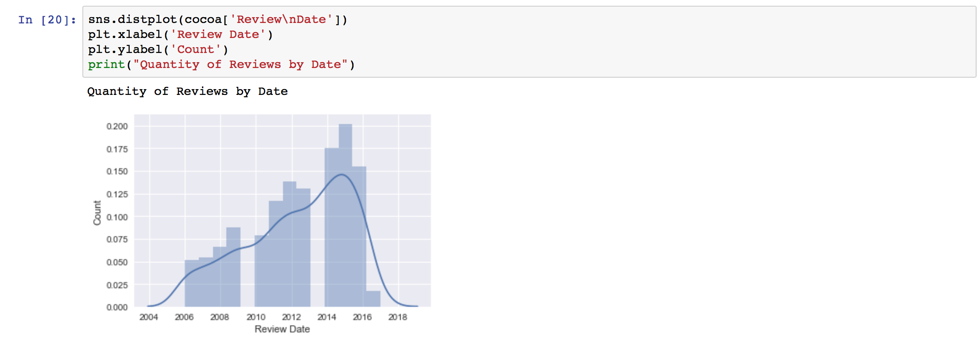
When were the reviews captured?
We can also see that most of the chocolate bars were reviewed in 2014-16, with the data collection starting in 2006, up until 2017.

Slide 9
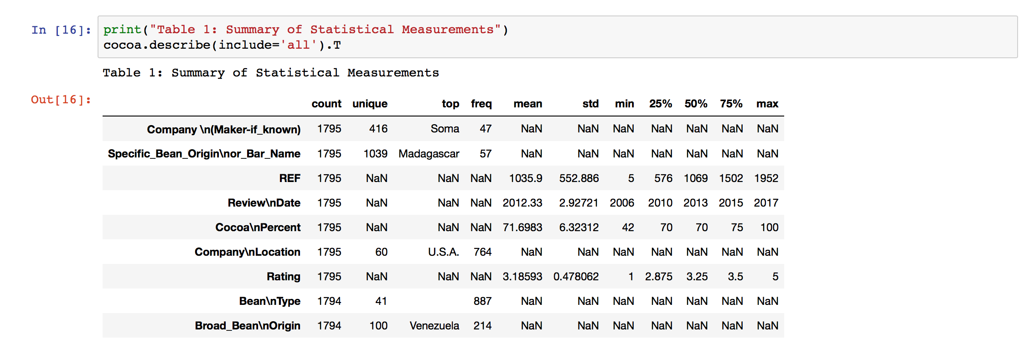
Is there a link between the cocoa percentage and the ratings?
We were able to see that the average percent of cocoa in a chocolate bar is around 70%, and the average rating for the chocolate bars is 3.1.

Slide 10
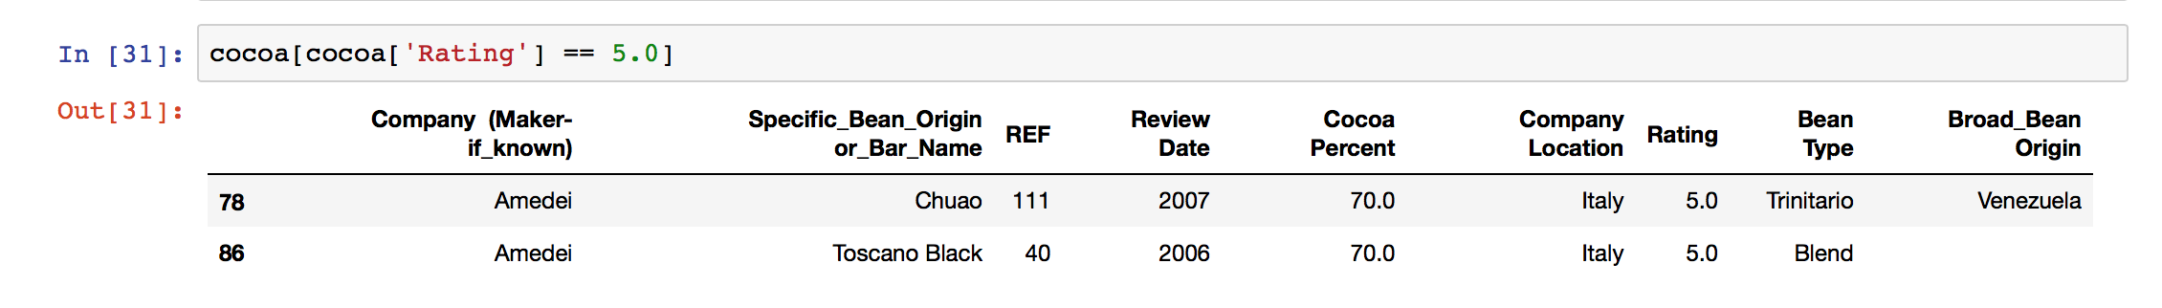
Which countries have the highest ratings?
Both highest rated chocolate comes from Italy and both have 70% cocoa percentage.

Slide 11
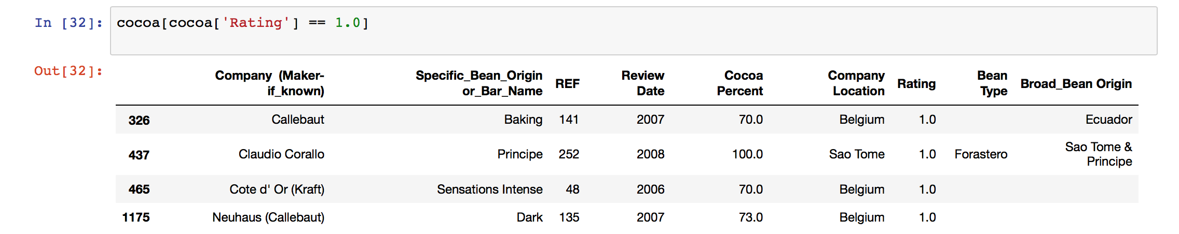
Which countries have the lowest ratings?
Three out of four of the lowest rated chocolates are from Belgium, and all have either 70% or close to 70% cocoa percentage.

Slide 12
Challenges with the dataset
The quality of the data wasn’t great, the format of the data was inconsistent. There were also multiple representations of the same data in the Specific Bean Origin column.
For example the below all represent the same Specific Bean Origin, written in 5 different ways.
Akesson's E., Sambirano V. Akesson's Estate Akessons Estate, Sambirano, 2013 Akessons Estate, Sambirano, Ambanja Akesson's, batch 4411
*We did not use this field for any of our analyses due to these types of inconsistencies.

Slide 13
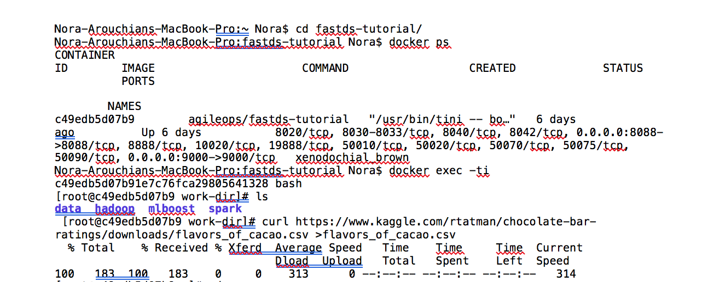
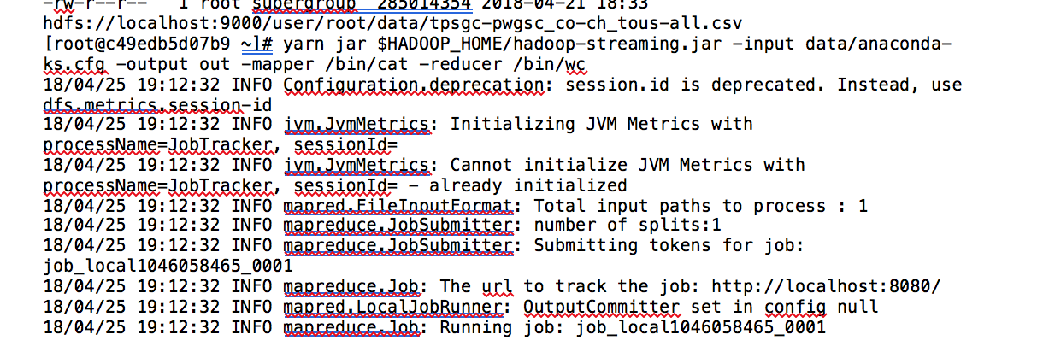
Command Lines from Terminal

Slide 14
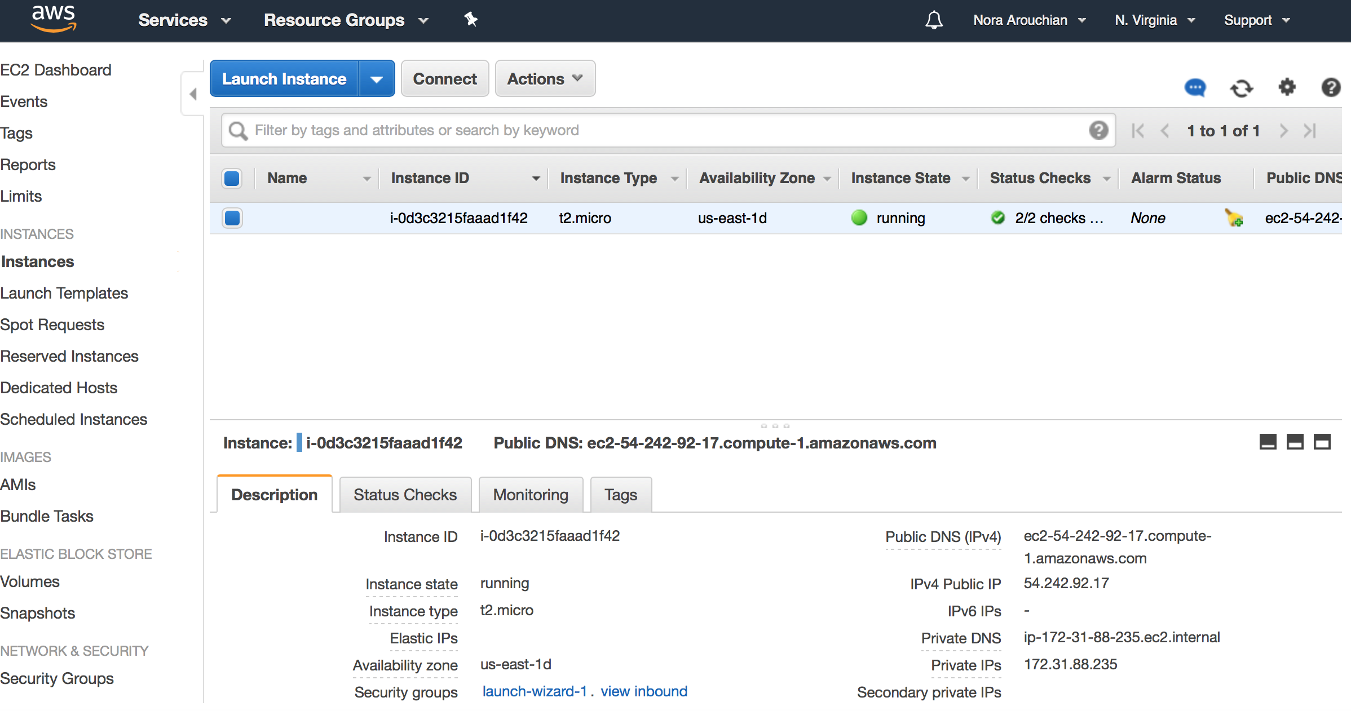
AWS Server used

Slide 15
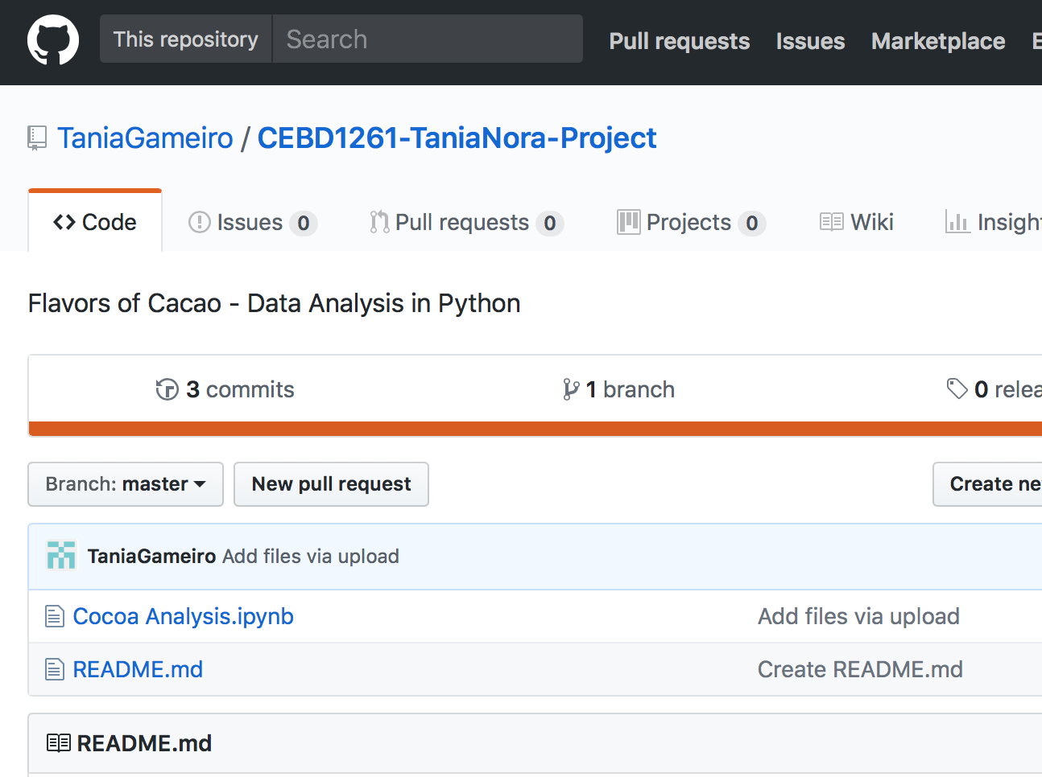
GitHub Repository
https://github.com/TaniaGameiro/CEBD1261-TaniaNora-Project.git

Slide 16
Interpretations, Recommendations & learnings
As with most open-source data, our takeaway was that we did spend over half of our time cleaning and prepping the data. Data quality is important, and we wanted to make sure our base was correct before moving forward to analysis. (60—40).
We learned that Americans had the highest chocolate consumption amongst all countries within the dataset – not surprising.
We also learned that people were biased and had a tendency to favorably rate chocolate, because chocolate is beloved by many.
We recommend to add an extra layer in the dataset, which would include Names of Vendors which are utilizing the Chocolate Companies, in order to determine favorability by Brand Name.

